Slide 1
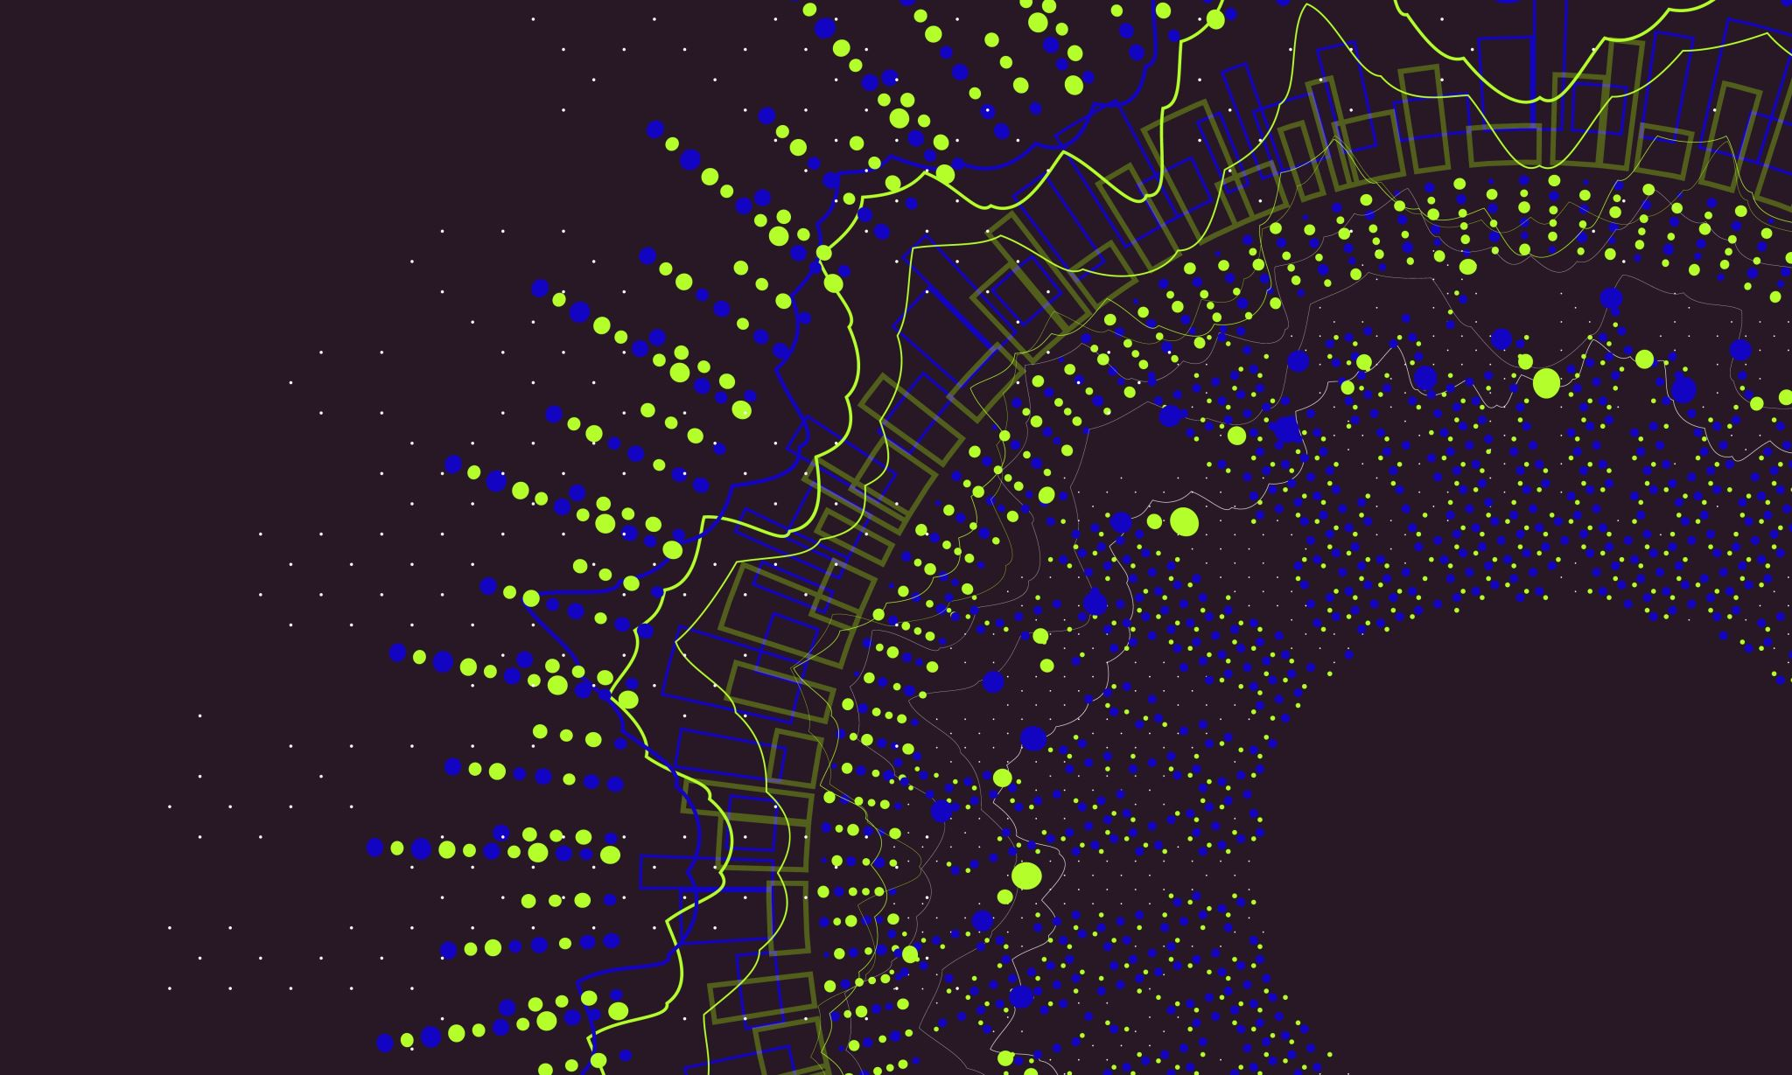
Spirituality Assembly
Ows, Wows and Nows
Mrs East
February 2025

Slide 2

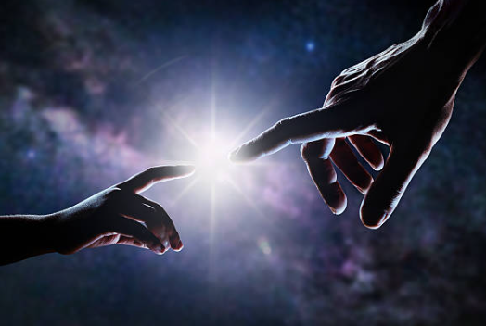
What is spirituality?
Spirituality is not always something we can see with our eyes; it's something we can feel inside ourselves. It's that special, quiet feeling of wonder when you see a beautiful sunset, or the love you feel for your family and friends. It's about being curious and asking big questions about the world and your place in it.
Spirituality is a feeling of connection - like a tiny thread that connects us to our families, our friends, and to the beautiful world around us. For Christians, this feeling of connection is also a special relationship with God, who made each of us unique and precious.

Slide 3
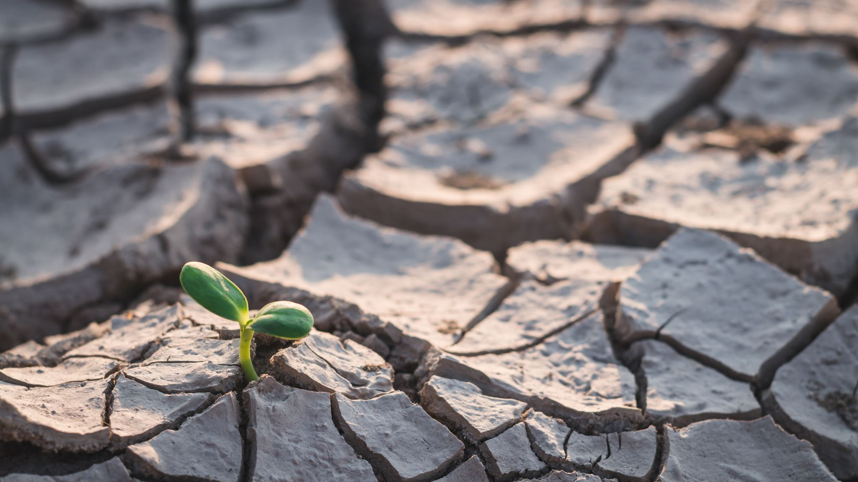
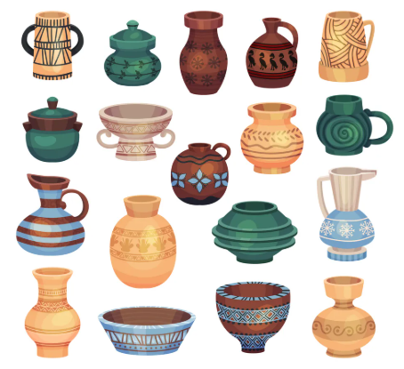
We are all unique and special
Imagine a potter's workshop. A potter has a big, lump of clay. The potter is very kind and gentle and has a wonderful idea in mind.
Christians believe that God is like that kind, loving potter, and we are the clay. He doesn't make everyone the same. He gives each person a different shape, a different colour, and a special design.
That's what it means when the Bible says, "We are the clay, you are the potter; we are all the work of your hand." (Isaiah 64:8) Every single one of us is God's special, unique masterpiece!

Slide 4
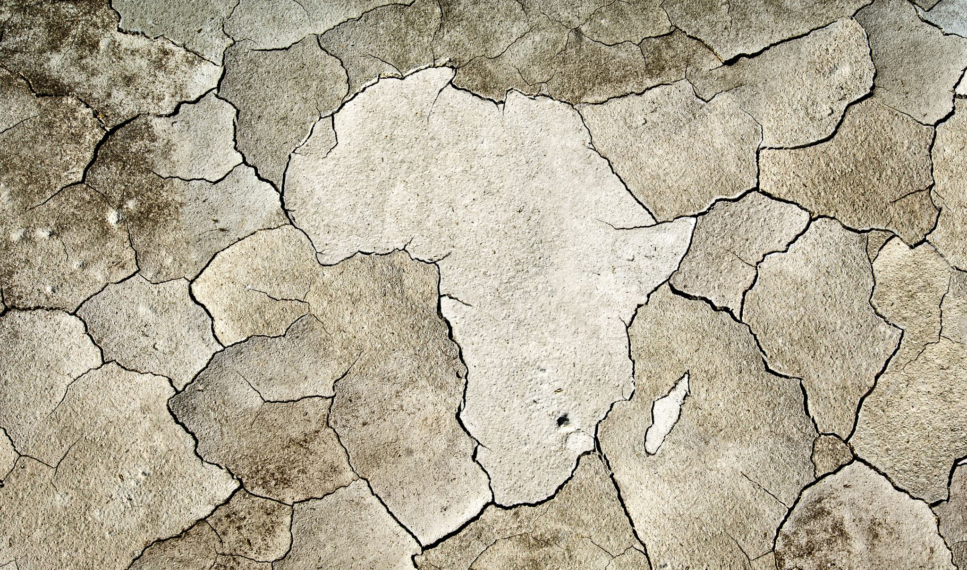
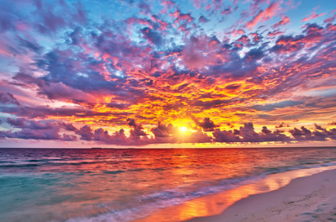
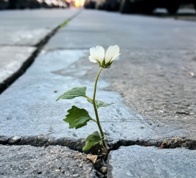
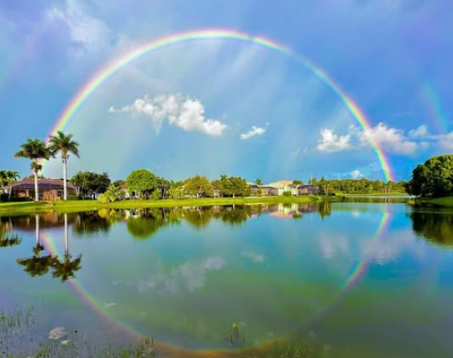
Have you ever seen something that made you go "WOW!"? Maybe it was a beautiful sunset, a tiny flower growing through a crack in the pavement, or a rainbow after the rain.
Christians believe that these "wow" moments are a way of feeling a bit closer to God. The Bible tells us that God is the loving creator who made each one of us. Every single one of us is a special and unique creation, and that's something to say "wow!" about!

Slide 5
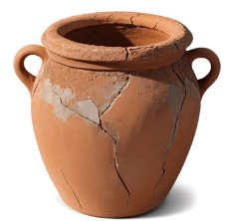
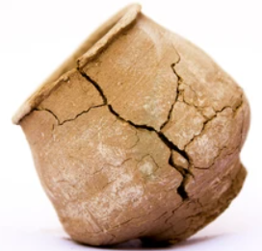
Ows, Wows and Nows
We are like special, handmade pots, made uniquely by our amazing potter, God. But our lives aren't always smooth. Sometimes, things happen that can make a little crack in us.
There are different kinds of cracks:
The 'OW' cracks are when something challenging happens, like a scraped knee or a hard day. These things can make us sad or hurt.
The 'WOW' cracks are when something so good and amazing happens that it fills us with wonder, like seeing a beautiful rainbow or getting a new puppy. Our hearts feel so full they could burst, and a special crack is made.
The 'NOW' cracks happen in the quiet, everyday moments. Maybe when you stop and listen to the birds singing, the wind through the trees or feel a snowflake drop on your skin. This moment of peace can make a little crack, too.

Slide 6
The Cracked Pot
(22) The Cracked Pot - YouTube

Slide 7
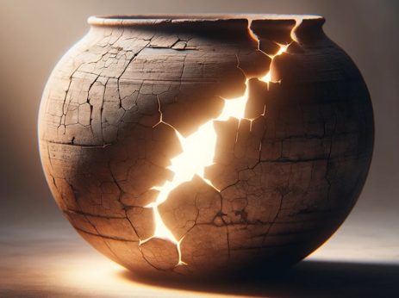
Christians believe that no matter what kind of crack we have - an 'OW', a 'WOW', or a 'NOW’ - God is there with his golden glue, ready to mend us. The golden lines on our pot show that something has happened to us, but that we were beautifully mended by God's love. They make our pot even more special and unique than it was before.
Christians believe that God's love is like a shining light inside us. When a crack appears, it's not something to hide. It's a chance for that beautiful light to shine out. It's like using golden glue to fix a broken pot. The golden lines show that something happened, but they also show how beautifully it was fixed. It reminds us that when we feel hurt, it's an opportunity to feel closer to God, who helps us shine even brighter than before.

Slide 8
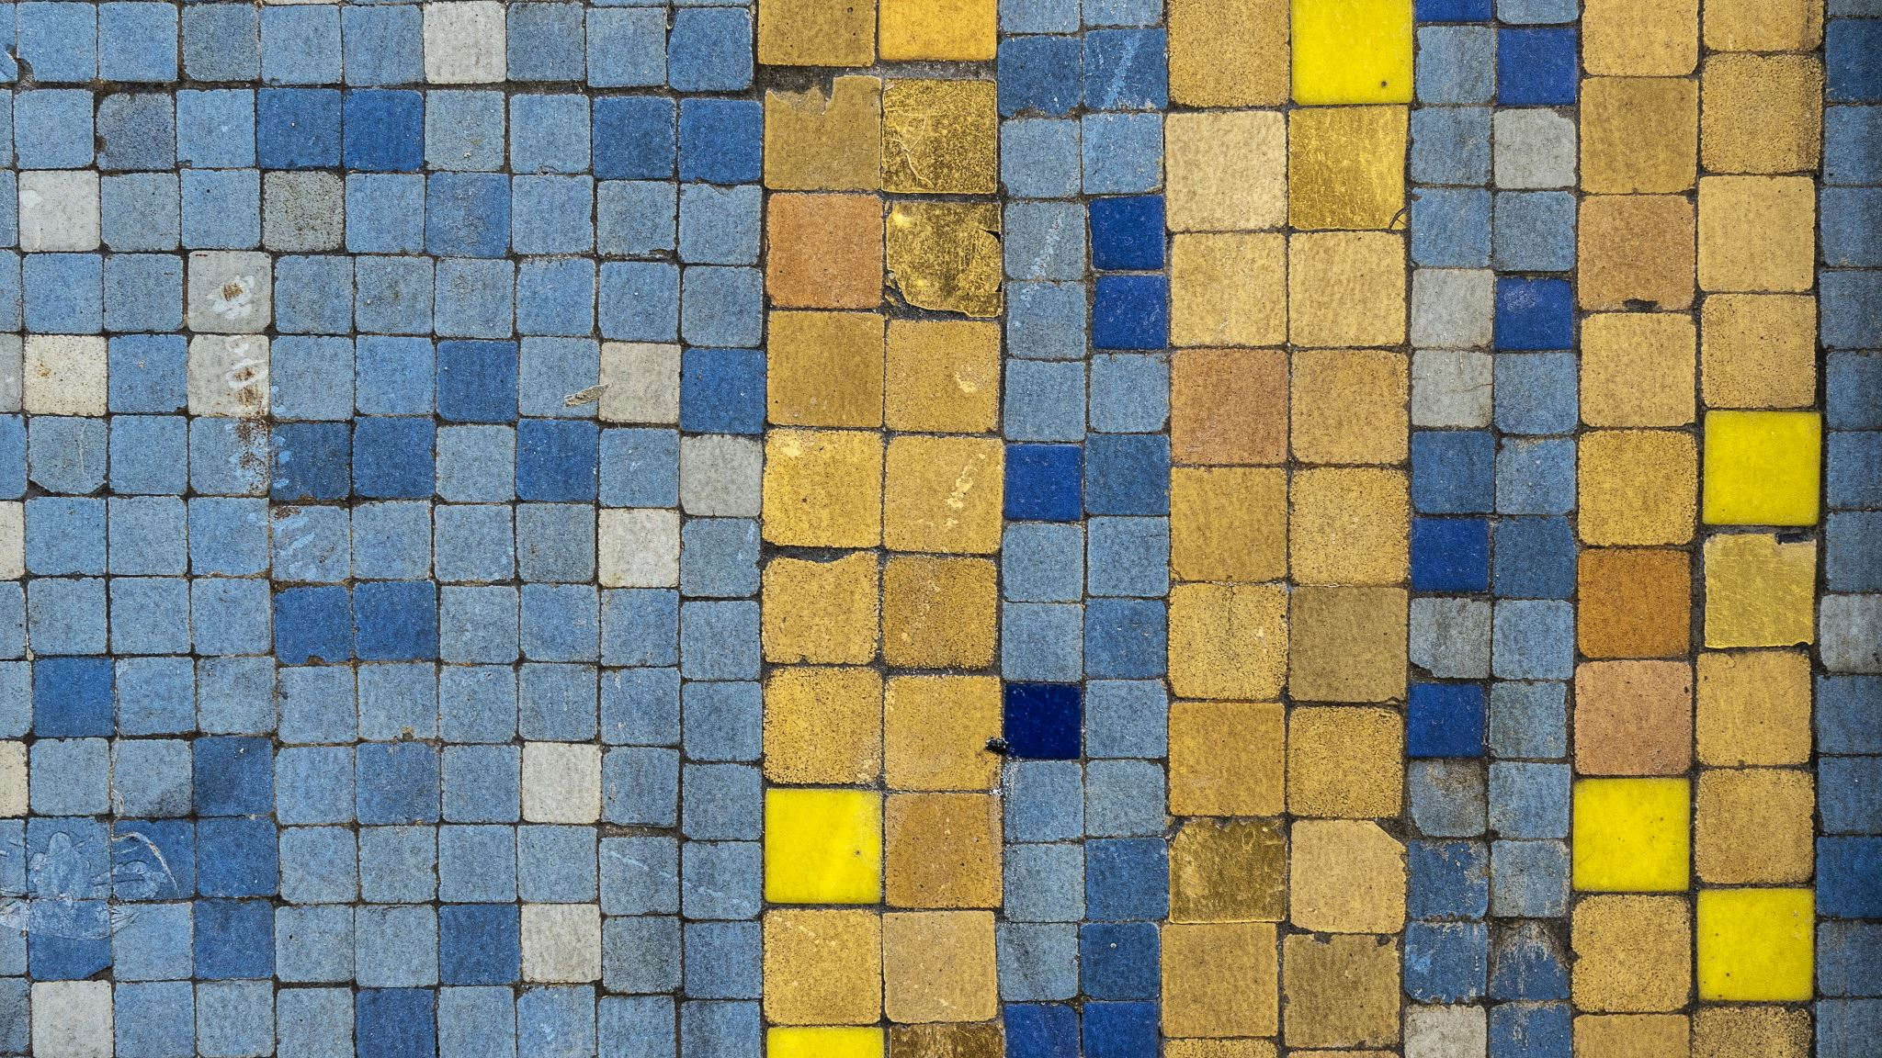
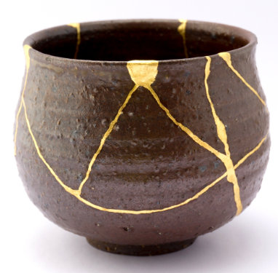
Broken but more Beautiful
Imagine a beautiful clay pot that gets broken. In Japan, there is a special way to fix it called Kintsugi, which means 'golden repair.' They don't just throw the broken pieces away. Instead, they carefully stick them back together with golden glue.
This doesn't hide the cracks, it celebrates them! The broken places become strong, shiny, and new. The pot becomes more beautiful and more valuable because of its golden repairs.
This is a beautiful way to think about our lives. When we have an 'OW' moment, a 'WOW' moment, or a quiet 'NOW' moment, God can mend the cracks in us with his loving golden glue. Our experiences, both happy and sad, add to our story and make us more unique and beautiful. God never throws us away, he always mends us with love.

Slide 9
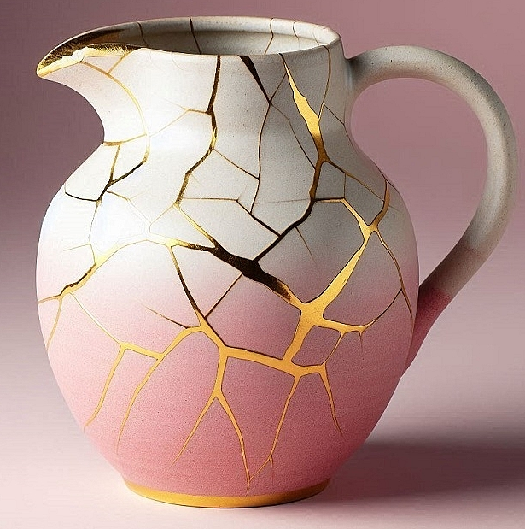
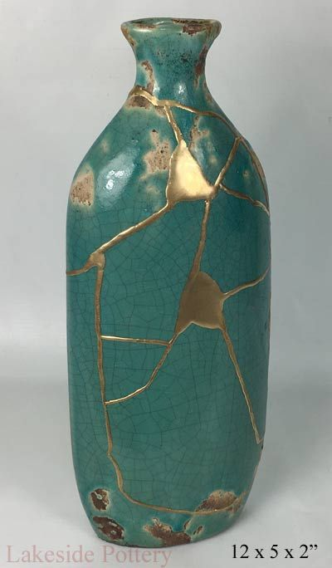
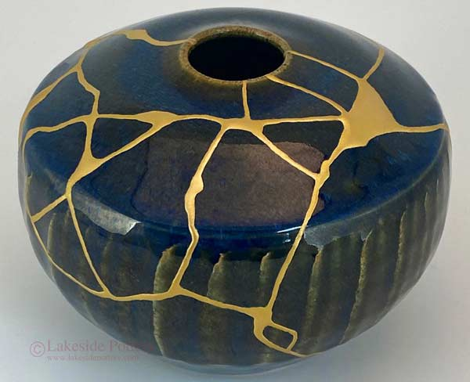
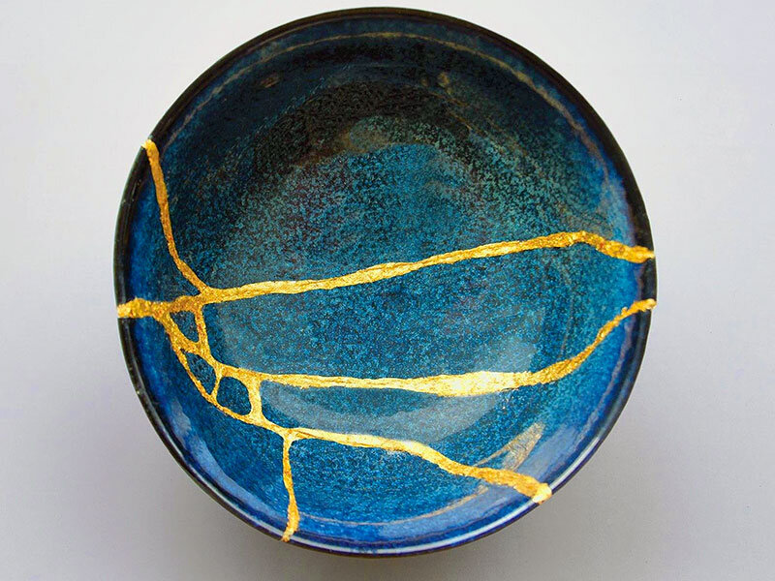
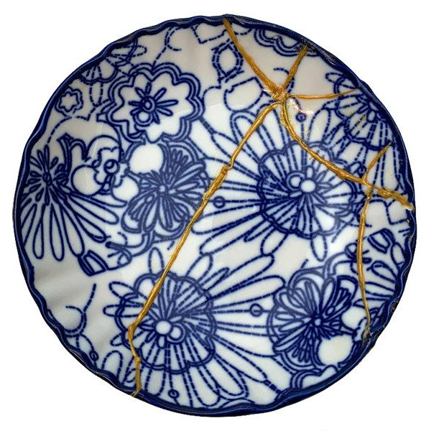
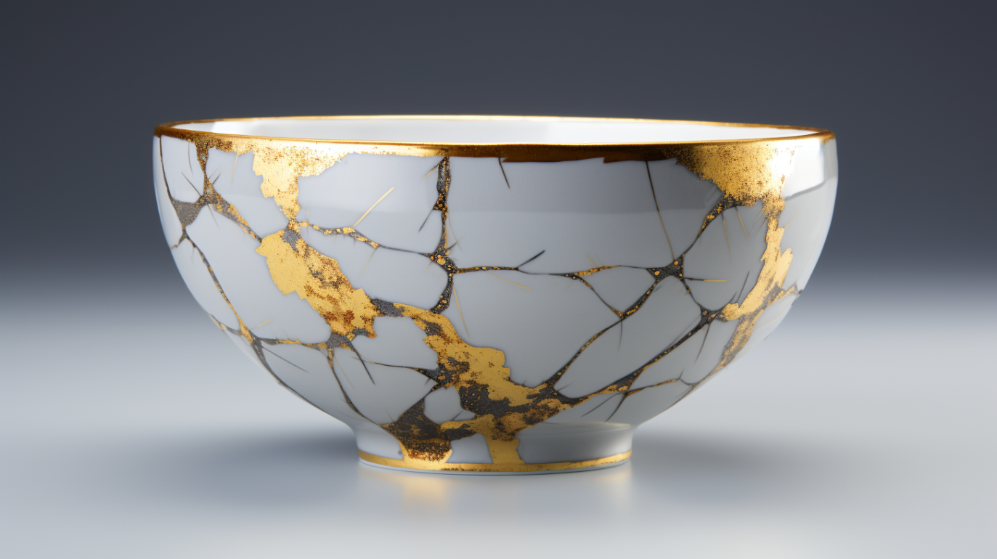
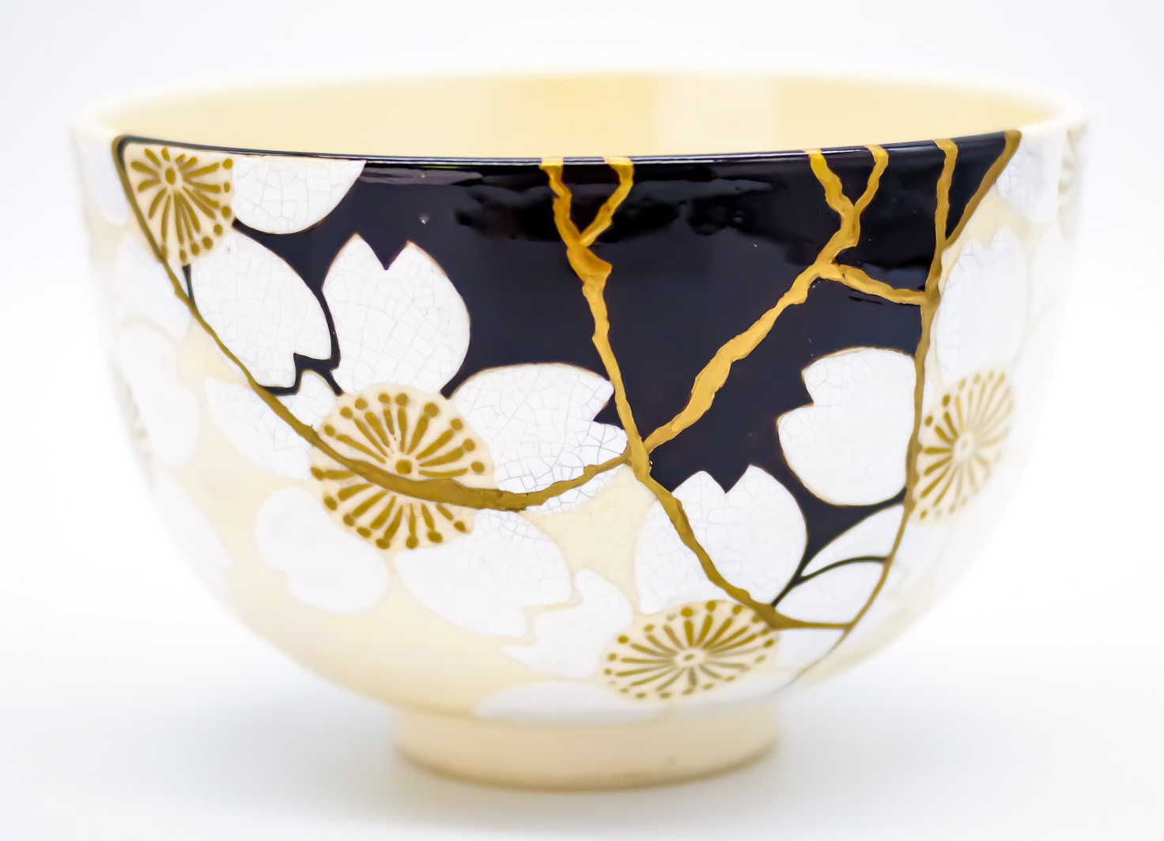
Kintsugi

Slide 10
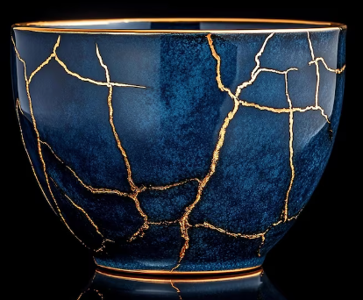
Be Kind to Every Pot
Just like us, everyone has their own golden cracks.
Be kind to everyone, because you never know what their story is.
Remember that everyone is made beautiful and special by God.

Slide 11
Let's take a moment now to think about what we've heard today. I invite you all to join me in prayer or have a quiet reflective moment.
Dear God, our loving potter,
Thank you for making each of us unique and special.
Thank you for the golden glue of your love, which mends our 'OW' moments, shines brightly in our 'WOW' moments, and fills us with peace in our quiet 'NOW' moments.
Help us to remember that our story, and every golden crack, makes us beautifully whole.
Amen

