Slide 1
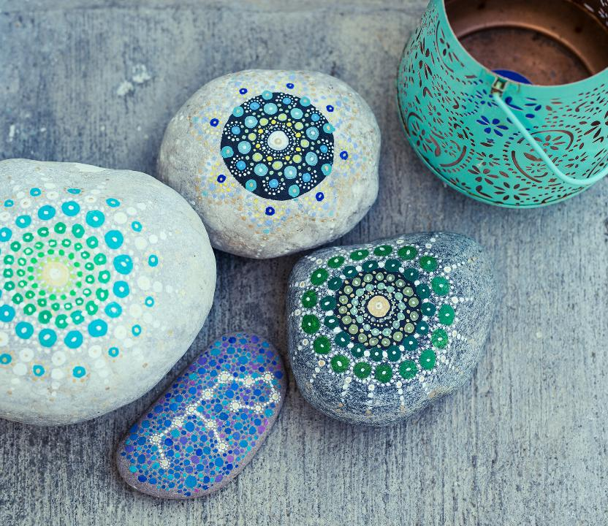
LAYING OF STONES Assembly
October

Slide 2
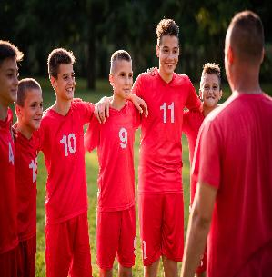
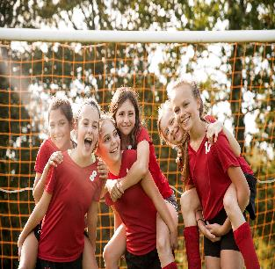
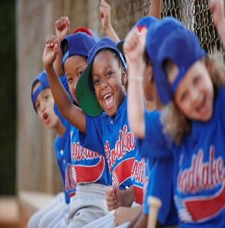
Burton Green CofE Academy
What does it mean to be part of a team?

Slide 3
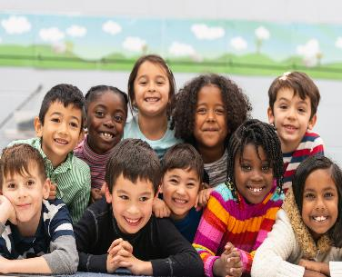
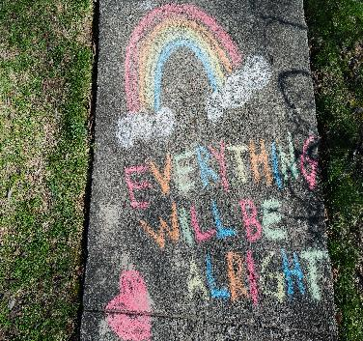
Friendship
On Good days
And Bad

Slide 4
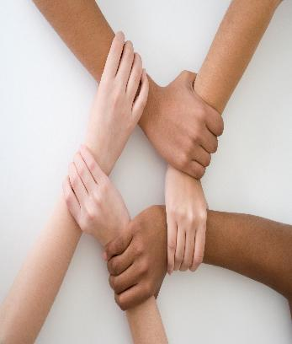

Support
And
Encouragement

Slide 5

It also means..
Belonging
Today, in laying your unique stone you are laying a symbol to show that you are part of Burton Green School.
Everybody at this school has laid a stone – both pupils and staff.

Slide 6

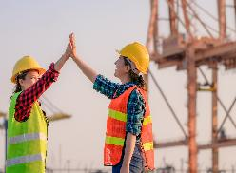
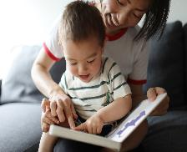
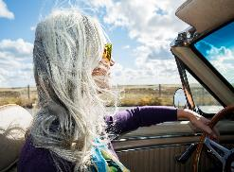
When you leave…
Secondary school
University
Working
Family
Old and maybe grey…

Slide 7


A little part of you will still be here.
And a part of Burton Green will also be part of who you have become

Slide 8
Move to the Peace Garden
Year 6 will introduce their new reception buddy
They will take them to lay a personalised stone in our Peace Garden
Everyone present will be invited to join in prayer together or to have a reflective moments
We will pray together - asking God to support and guide us today and every day to value ourselves, each other and the world in which we live.

