Slide 1
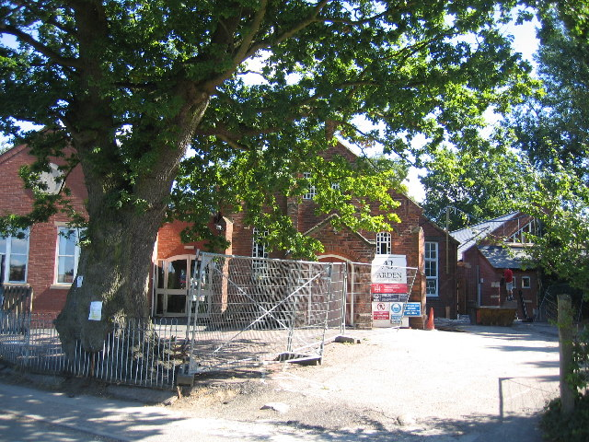
Spirituality at Burton Green
What Make Us Unique and Special?

Slide 2
What events in our lives shape who we are and the sort of person we become?
WOWs
OWs
NOWs

Slide 3

WOWs
These are the awe and wonder moments. The times you want to breathe in and capture that feeling, holding on as long as you can.

Slide 4

OWs
These are the things that can go wrong. These moments can knock the breath out of you.

Slide 5

NOWs
These are the everyday ordinary times and being able to be present in that moment and thinking how lucky we are to be here now.

Slide 6
How Do These Events Shape Us?
They impact our emotions
We feel them
We remember them
We learn from these events in both positive and negative ways
They shape how we deal with events in the future.
NOWs are the ones we sometimes do not recognise, we take things from granted such as; friends, school, food, health.

Slide 7
Think about yourself
WOWs - Positive
Meeting new friends,
Having a baby brother or sister,
Moving home or school
OWs – Negative
Losing a friend
Moving school or home
A relative moving away
NOWs – everyday events
Good health
Friends

Slide 8
How does this link to Christianity?
God loves each and every one of us
Sometimes we wonder why God lets us experience sad or painful events?
God wants us to be the best versions of ourselves every day
To value ourselves
To value others
To value the world around us
Our character is shaped by our experiences making us all unique because we all experience different things

Slide 9
Prayer
I invite you all to join me in prayer – or have a quiet reflective moment.
Lord our God,
Help us today and every day, to have the strength in dealing with all our personal experiences,
To grow in character,
To value the good days and to cope with the bad,
Please guide us in everything we do, so we grow to be the best versions of ourselves possible,
Amen

